Slide 1


University of Pittsburgh Department of Otolaryngology Update
José P. Zevallos MD MPH FACS
Pittsburgh Eye and Ear Foundation Board Meeting
November 29, 2023

Slide 2
Outline
Faculty recruitment
Clinical growth and research
Pittsburgh Hearing Institute
New Foundation grants
Priorities for 2024

Slide 3
Faculty Recruitment by the numbers
10 New Faculty
8 clinical faculty
2 PhD researchers
2 New Division Chiefs
6 Assistant Professors, 2 Associate Professors, 2 Professors
50% Female
4 New NIH grants (R01 x 2, R21, K99)

Slide 4
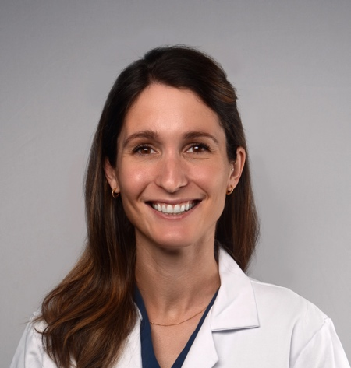
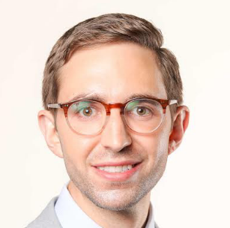
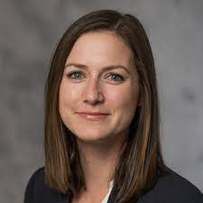
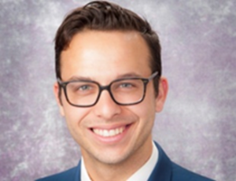




Recruitment: Assistant Professors (Clinical)
Christina Yver MD
Facial Plastic Surgeon, Facial Nerve
Residency: University of Pennsylvania
Fellowship: Harvard/MEEI Facial Nerve Center
Kevin Contera MD MPH
Head and Neck and Microvascular Reconstructive Surgery
Residency: Cleveland Clinic
Fellowship: MD Anderson Cancer Center
Chloe Santa Maria MD
Laryngology
Residency: Stanford University
Fellowship: University of Southern California
Thomas Kaffenberger MD
Sleep Medicine and Surgery
Residency: Pittsburgh
Fellowship: Thomas Jefferson

Slide 5
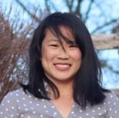
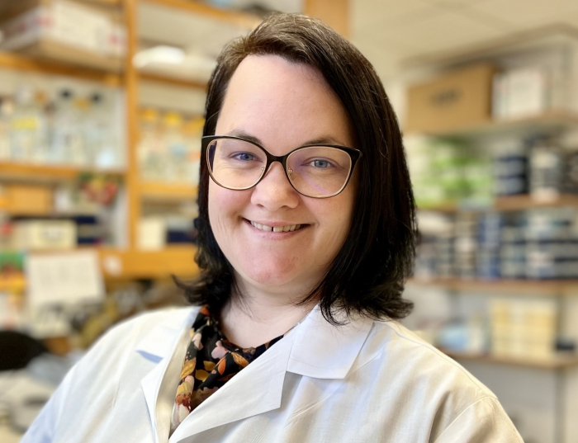


Recruitment: Assistant Professors (Research)
Angela L Mazul PhD MPH
Head and Neck Cancer Epidemiology and Population Sciences
Hillman Cancer Center
Previous Position: Washington University Department of Otolaryngology-Head and Neck Surgery
Melissa McGovern PhD
Gene Therapy, Hearing Loss
Pittsburgh Hearing Research Center
Previous Position: postdoc, Baylor College of Medicine

Slide 6
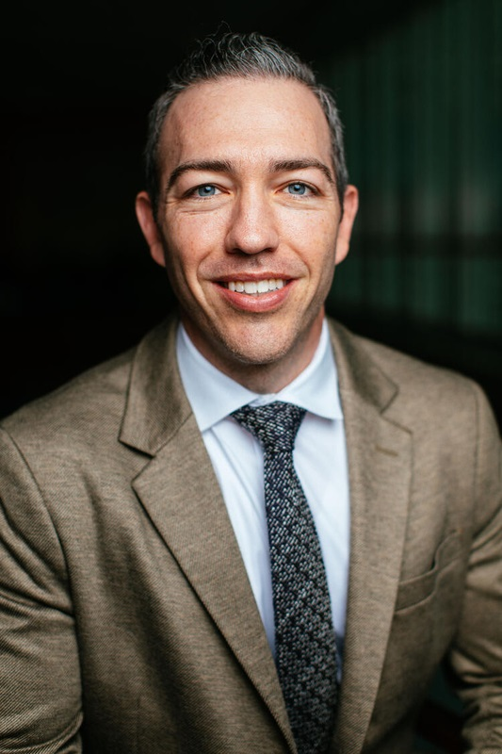
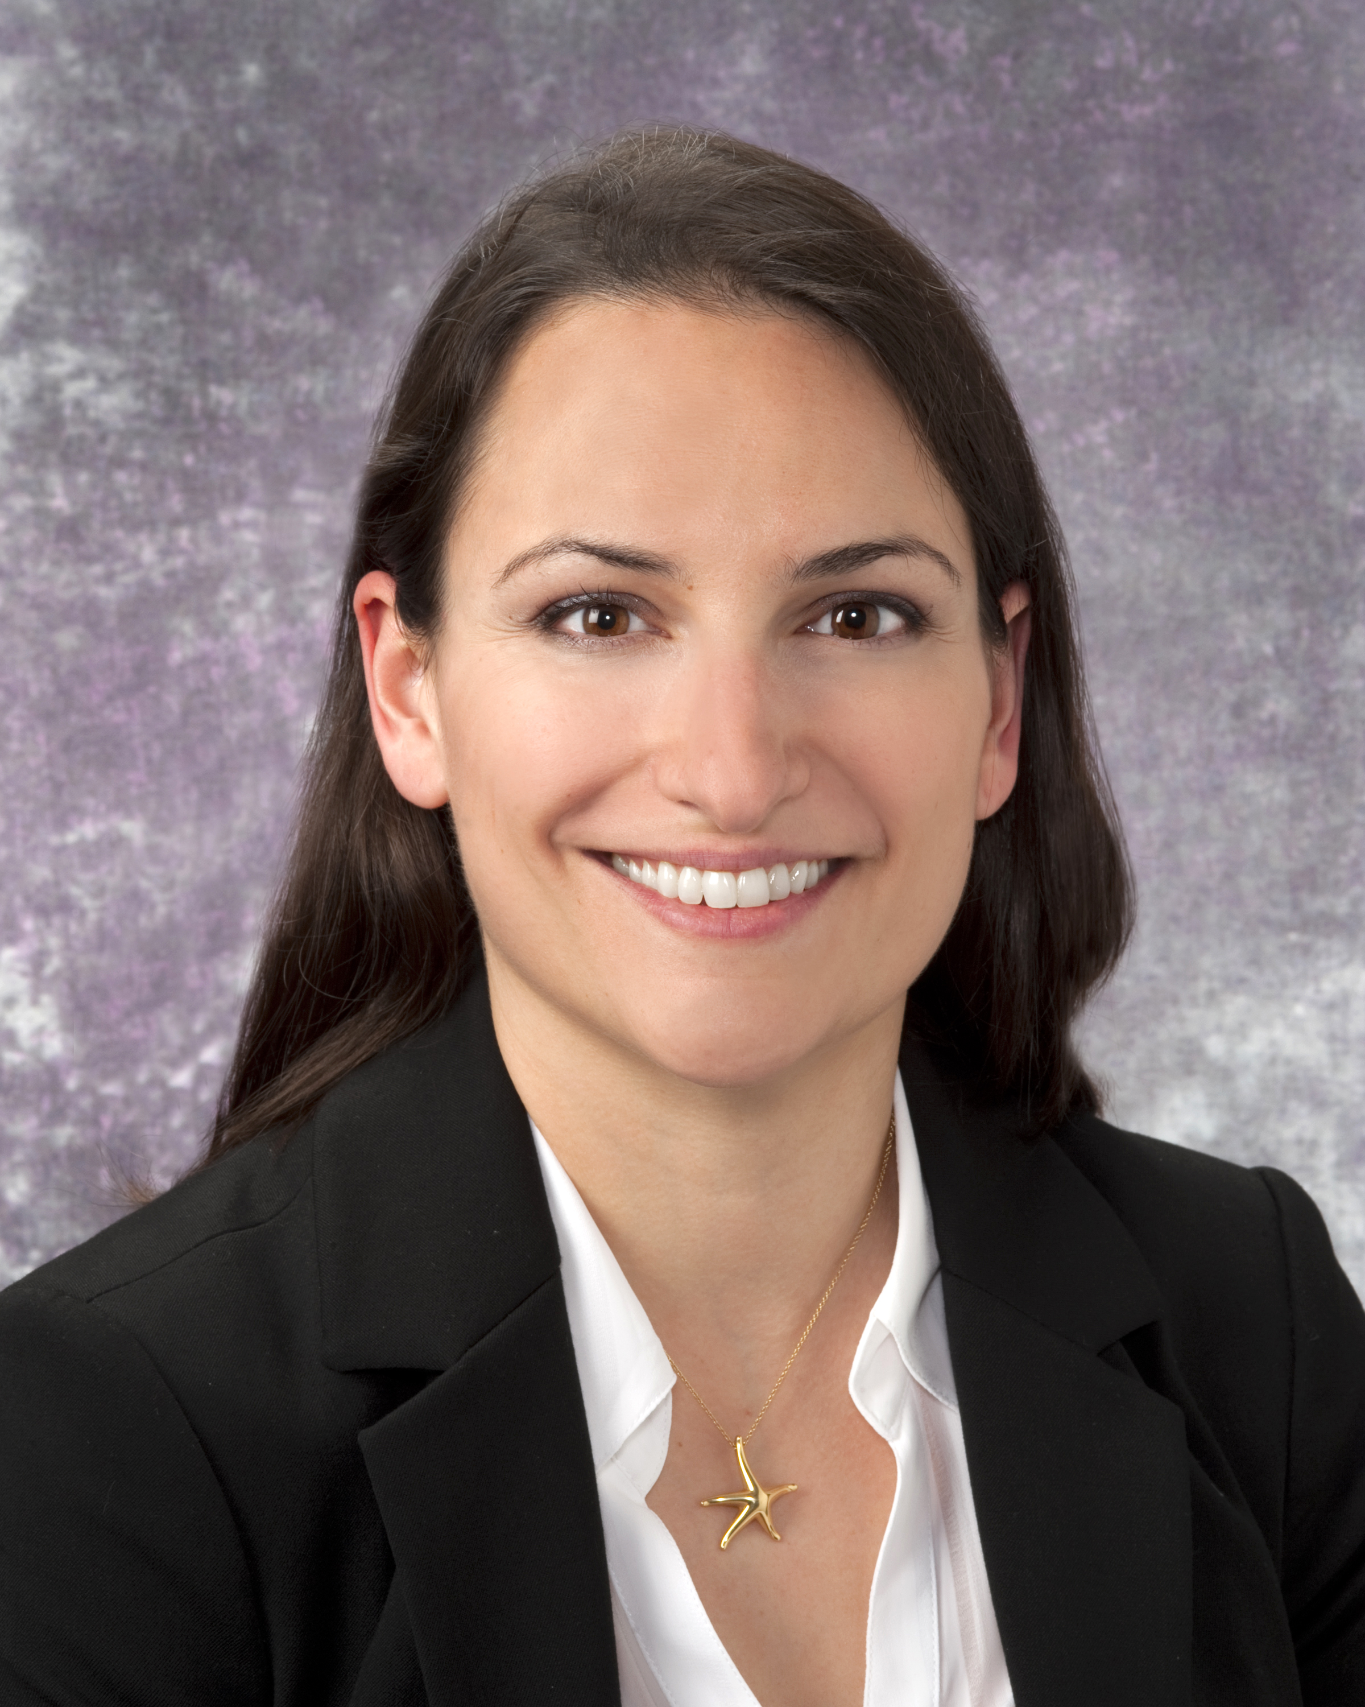



Recruitment: Associate Professors
Garret Choby MD
Rhinology and Skull Base Surgery
Residency: Pittsburgh
Fellowship: Stanford University
Previous Position: Vice Chair of Quality, Mayo Clinic Department of Otolaryngology-Head and Neck Surgery
Jessica Maxwell MD MPH
Pittsburgh VA Chief and Associate Residency Program Director
Head and Neck Surgery
Residency and Fellowship: Pittsburgh
Previous Position: Chief, Washington DC VA/Georgetown University Department of Otolaryngology-Head and Neck Surgery

Slide 7
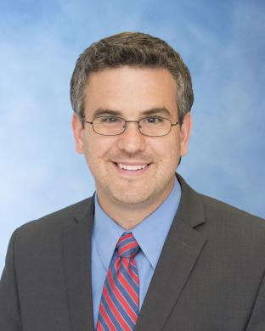

Division Chief of Head and Neck Microvascular Reconstruction
Matthew Spector MD
Professor, Division Chief of Head and Neck Surgical Oncology and Microvascular Reconstruction
Residency: University of Michigan
Fellowship: University of Michigan
Previous Position: Co-director of Head and Neck Cancer Program, University of Michigan Department of Otolaryngology-Head and Neck Surgery
Immediate Positive Impact on Resident and Fellow teaching, free flap volume and case duration, comraderie in Head and Neck Division

Slide 8
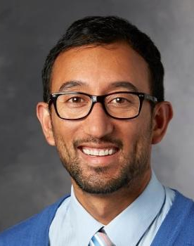
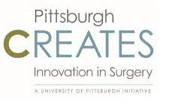


Division Chief of Otology and Neurotology
Peter Santa Maria MD PhD
Professor, Division Chief of Neurotology
Vice Chair, Clinical and Translational Research
Director of Faculty Innovation, University of Pittsburgh
Residency: University of Perth (Australia)
Fellowship: Stanford University
Previous Position: Associate Professor, Stanford University Department of Otolaryngology
Associate Director, Stanford University SPARK Program in Entrepreneurship
Director, Global SPARK program

Slide 9

UPMC Otolaryngology Service Line Expansion
New UPP Sites
UPMC Hamot: Head and neck surgical oncology
UPMC East: head and neck surgical oncology, laryngology
UPMC West Mifflin: General otolaryngology
UPMC Harrisburg: Head and neck surgical oncology and reconstruction
Strengthening collaboration with CMI at UPMC Passavant, UPMC St. Margaret’s

Slide 10
#2 in Nation in NIH funding for 2022

Slide 11
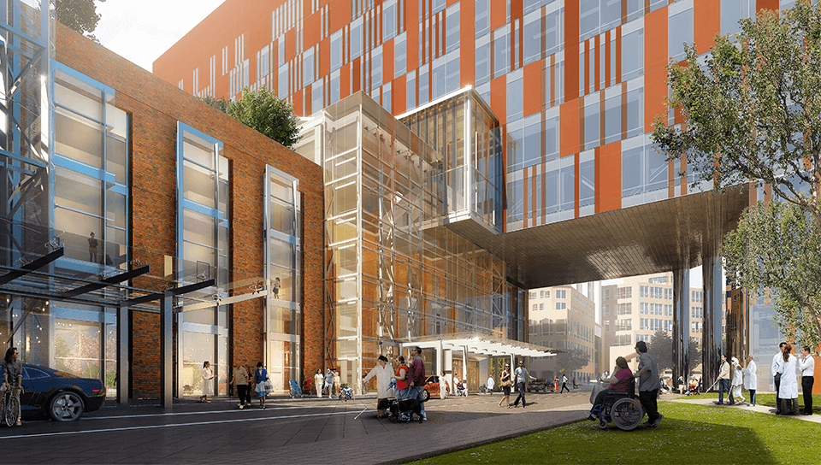
The Pittsburgh Hearing Institute

Slide 12
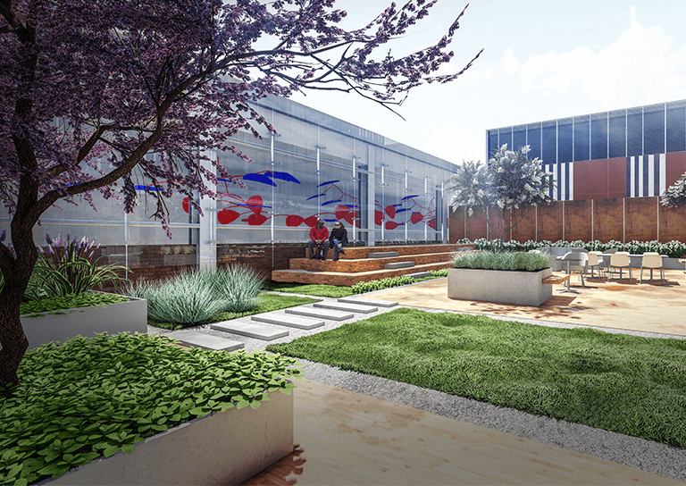
Vision
To establish the world’s leading institute for treating and finding cures for hearing loss
Co-location of neurotology, audiology, vestibular, and translational and basic science research programs at UPMC Mercy to facilitate a true bench to bedside approach to curing hearing loss.
Recruitment of 4-5 new world-class hearing scientists

Slide 13

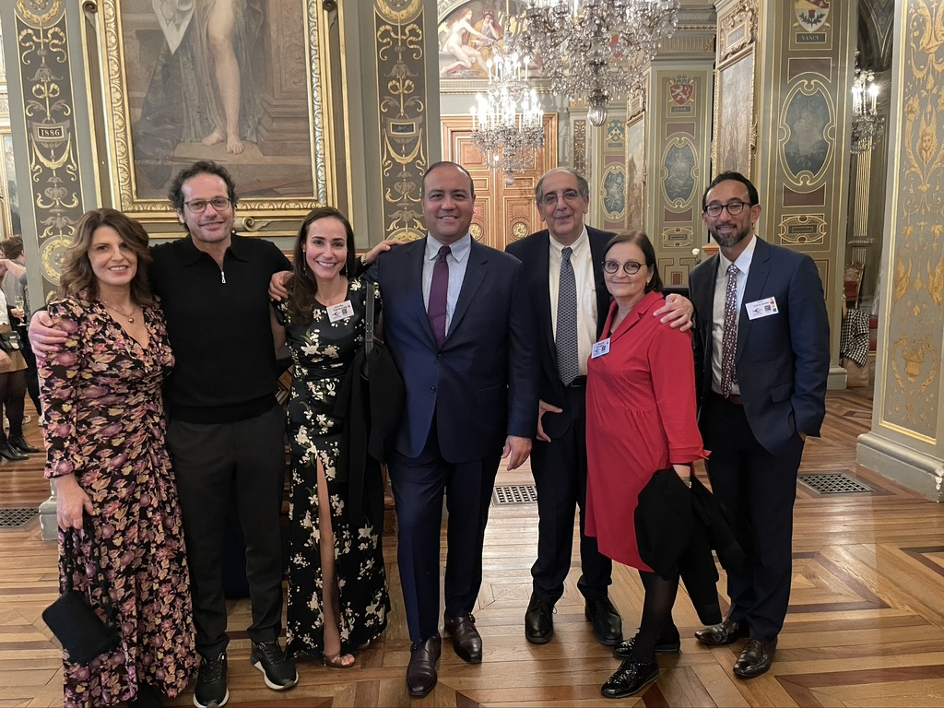
Visit to Institut de ’Audition, Paris, France
Dr. Anantha Shekhar, Dr. Thanos Tzounopoulos, Dr. Peter Santa Maria
Collaboration with French hearing scientists, plan for annual joint meeting
Thank you to Dr. Sahel!

Slide 14
Research: Grants and Publications
PHRC 2022-2023 Active NIH Grants
R01 | 6
R00 | 1
R21 | 2
~ $4 Million
per year in grants (NIH, NSF, DoD, Foundations)
Selected Publications
Cell-type-specific plasticity of inhibitory interneurons in the rehabilitation of auditory cortex after peripheral damage.
M Kumar, G Handy, S Kouvaros, Y Zhao, L Ljungqvist Brinson, E Wei, B Bizup, B Doiron, T Tzounopoulos
Nature Communications. Jul 13, 2023.
A CRE/DRE dual recombinase transgenic mouse reveals synaptic zinc-mediated thalamocortical neuromodulation.
S Kouvaros, B Bizup, O Solis, M Kumar, E Ventriglia, FP Curry, M Michaelides, T Tzounopoulos
Science Advances. Jun 9, 2023.
Control of stereocilia length during development of hair bundles. JF Krey, P Chatterjee, J Halford, C Cunningham, BJ Perrin, PG Barr-Gillespie.
PLOS Biology. Apr 3, 2023.
Otolaryngology 2022 NIH Ranking
JOHNS HOPKINS | $17,171,505
PITT | $11,856,112
VANDERBILT | $10,682,026
Otolaryngology 2021 NIH Ranking
JOHNS HOPKINS | $14,455,105
VANDERBILT | $8,914,300
PITT | $7,897,972

Slide 15
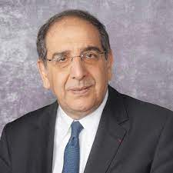

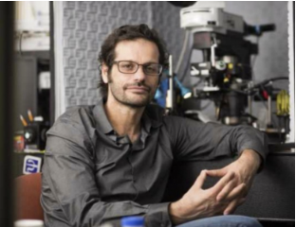
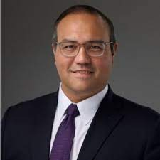
New Graduate Certificate Program
in Hearing Vision Sciences is live!
A unique collaborative graduate program, designed to train the next generation of hearing and vision researchers both in basic and translational research.
It will attract and train top graduate students and leverage the strengths of our world-class hearing and vision sciences programs. As such, this program will train new graduate students and serve the needs of our faculty
The departments of Otolaryngology (2), Ophthalmology (2) and Brain Institute (1) will fund 5 students per year for the first 5 years, and then we will apply for a T32 training grant to continue support.
Approved by the SoM. Currently in the process of being approved by the University. Anticipated enrollment – Spring 2024

Slide 16




$ 1M for improving Head and Neck Cancer in Patients with Intellectual Disabilities
New Foundation Grants to the Department
$ 100K Weigand Entrepreneurial Research Award to Dr. Catherine Palmer for LiDIA: Listening, iDentification and Instant Amplification
$200K for new Head and Neck Cancer Patient Navigator Program
$ 100K for Early Head and Neck Cancer Detection through Liquid Biopsy Technology

Slide 17

Priorities for 2024
Ensuring patients have access to the world class care, at the right place, at the right time
Head and Neck Cancer Center at UPMC Shadyside | Pittsburgh Hearing Institute at UPMC Mercy | EEI/PUH Remaining Services
Alignment with radiation and medical oncology services currently located at Shadyside Access to translational research and clinical trials | Surgeons operating there yet seeing patients at EEI Vestibular patients traveling to tertiary hospital for outpatient services. Opportunity to co-locate clinics and labs to foster new clinical innovation and research. | Neurosurgery-facing surgeries, skull base and rhinology Maxillofacial trauma Administrative suite Smaller head and neck footprint

Slide 18

Priorities for 2024
Pittsburgh Hearing Institute
Creation of a Head and Neck Cancer Center, in conjunction with Dr. Ferris and the UPMC Hillman Cancer Center
  Consolidation of strengths in head and neck cancer translational research, clinical care, and patient outreach in a single center at SHY hospital
  Latest technology
  Kick-off at Winter Academy in Naples
Focus on other Divisions
  Facial plastic surgery, UPMC Facial Nerve Center
  Laryngology, growing our footprint in the arts community in Pittsburgh

Slide 19
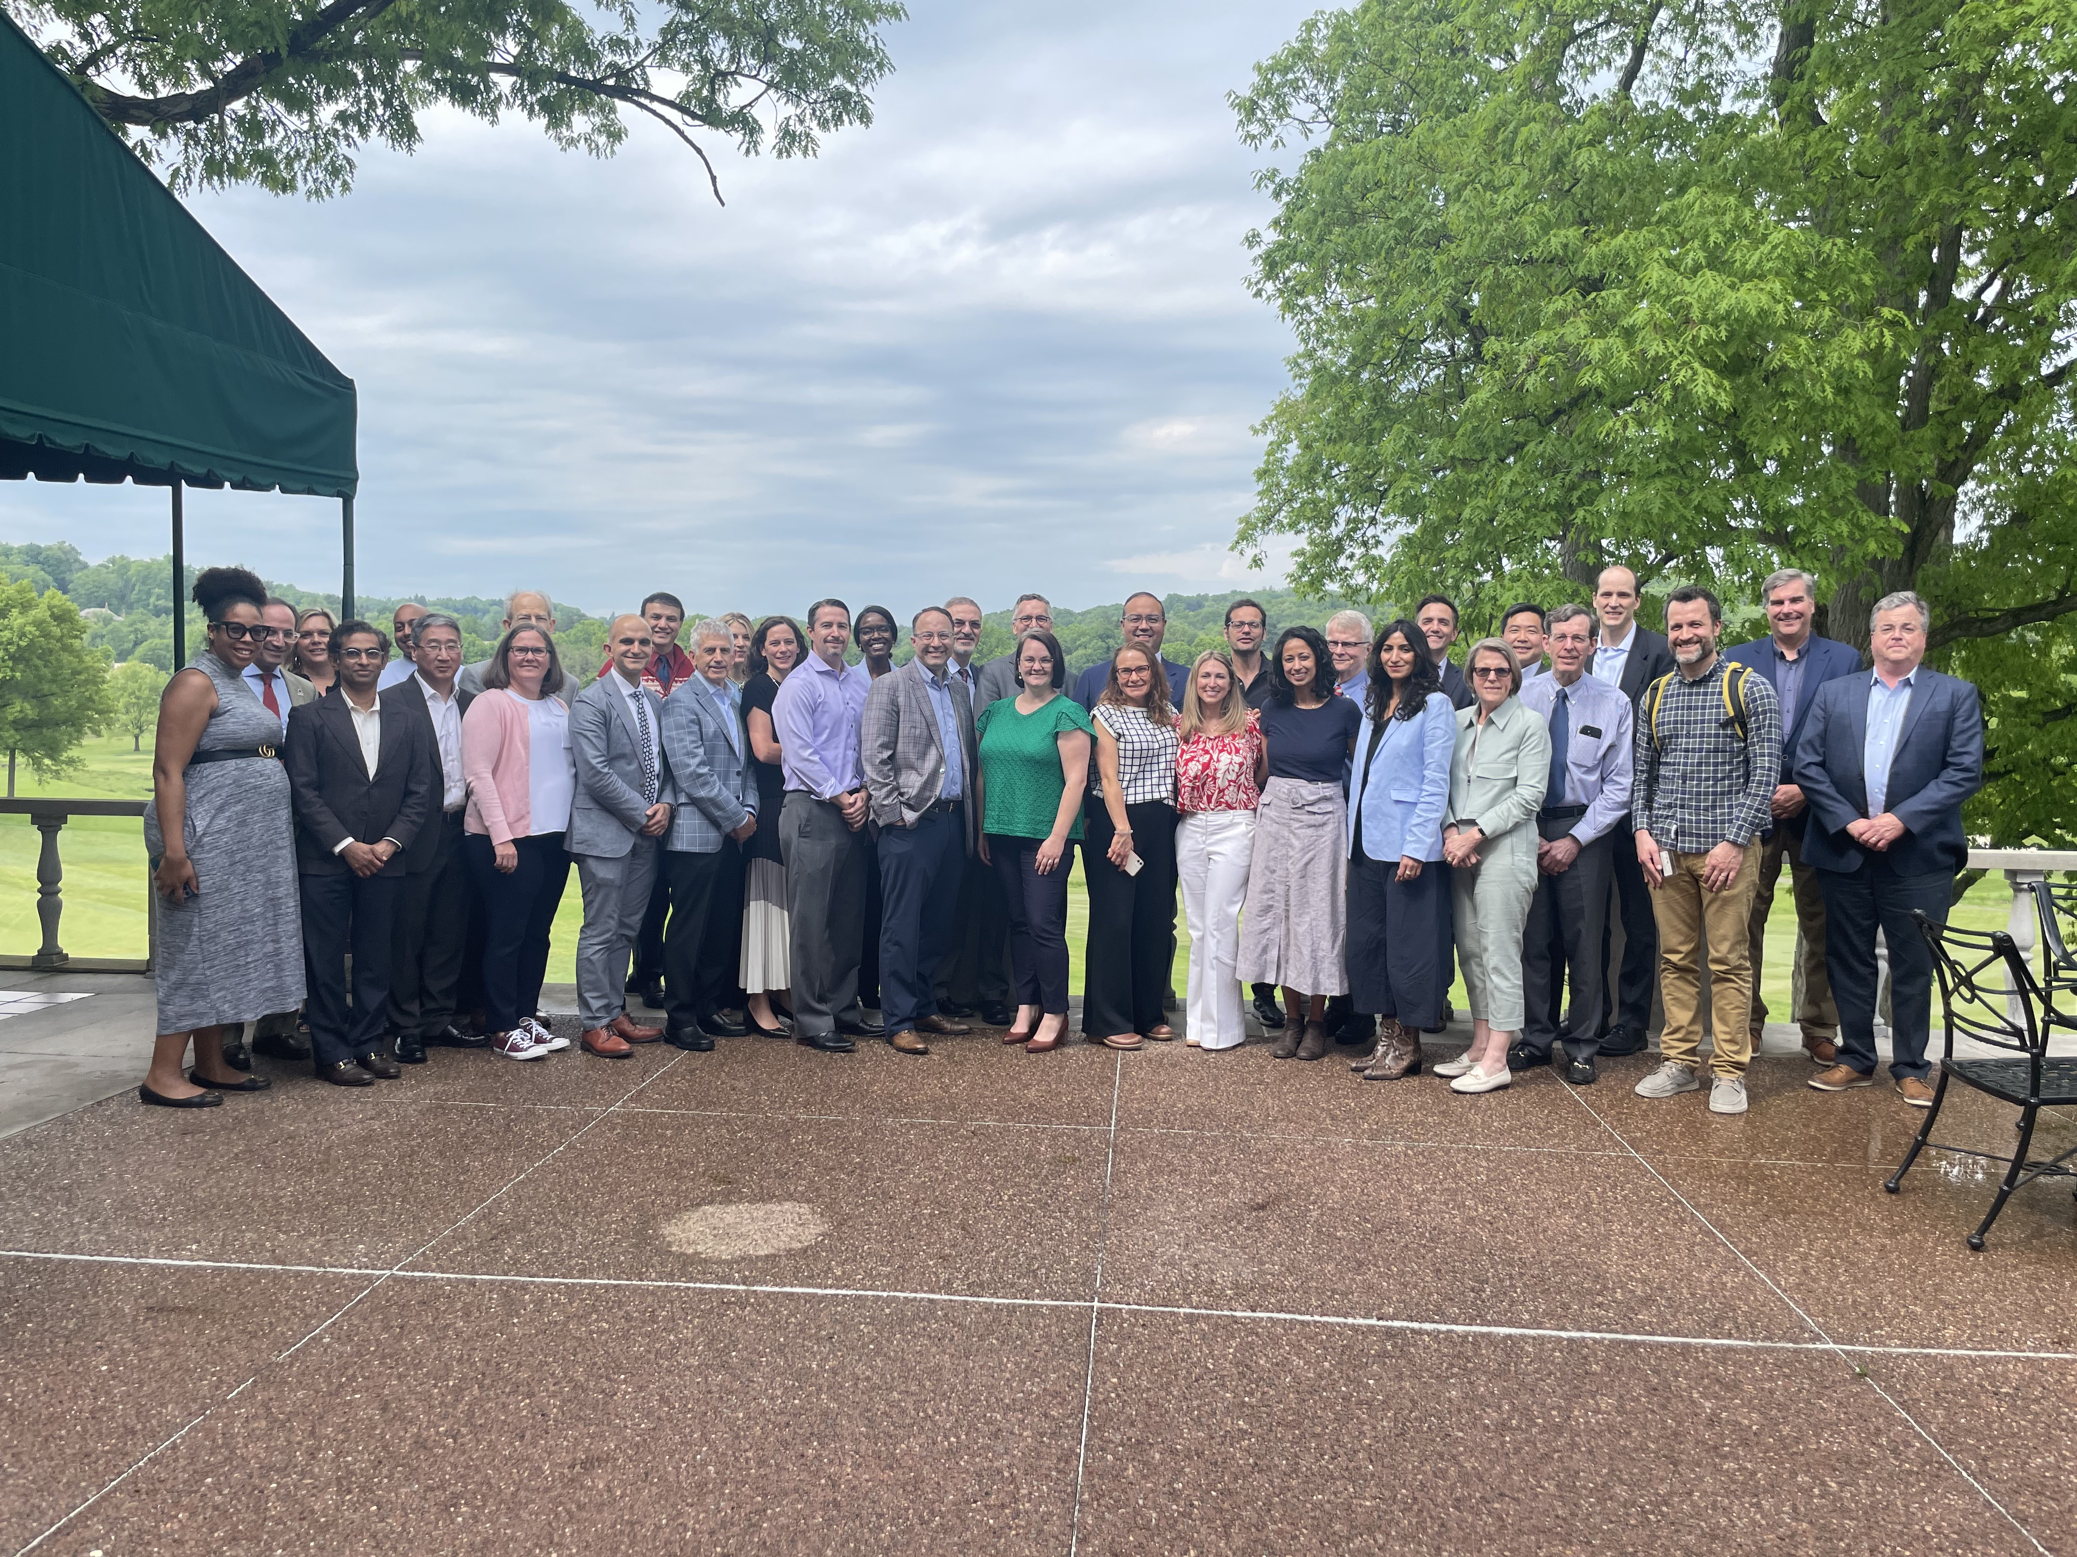
Thank you
Values
Patient Care First
Diversity and Inclusion
Accountability
Scholarship

